Slide 1
Counting Fruit Pieces
December 7 - Now

Slide 2
Overview
Provide a digital tool for Yoplait plants to calculate the number of fruit pieces per yogurt cup.
Likeness scores go up with the more fruit pieces in the cup
Counting fruit pieces has been subjective
Operator differences
Method differences
Resource constraint: Time it takes to count fruit pieces is a long and tedious process.

Slide 3
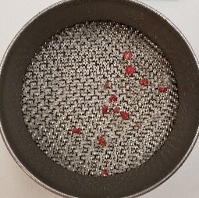
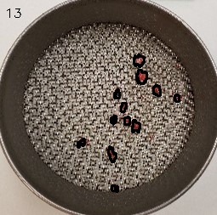
Input - Output

Slide 4
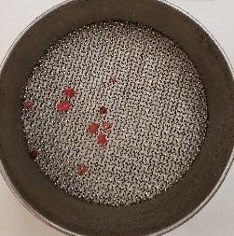
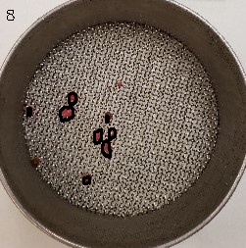
Input - Output

Slide 5
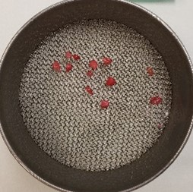
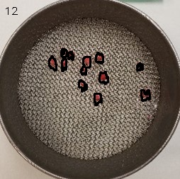
Input - Output

Slide 6
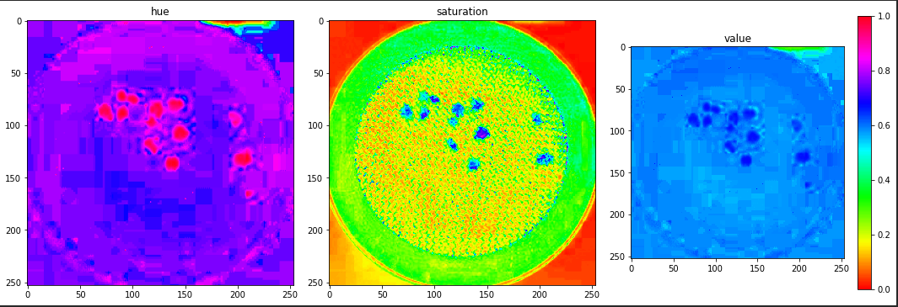
Approach (1/3)
Image was converted from RGB to HSV to get the Hue, Saturation and Value properties

Slide 7

Approach (2/3)
Using these properties, image was masked to get our region of interest, ie the ones with the correct threshold value for hue, saturation and color value
Original
Masked

Slide 8
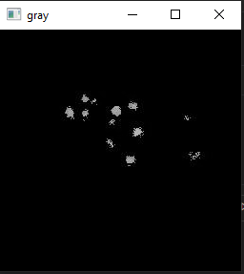
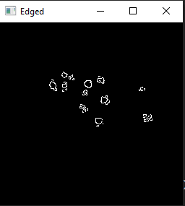
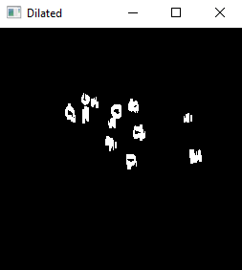
Approach (3/3)
From this masked image - Converted it to grayscale image, detected edges and dilated the image for accuracy
Gray
Detected edges
Smoothened boundaries

Slide 9
Output
Using masked image to draw contours and put it on original image

Slide 10
Other approaches
Grayscale and then using intensity of pixels
Just focusing on the range of red pixels since it would only be strawberries

Slide 11
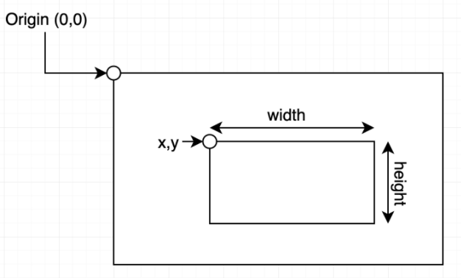

Slide 12
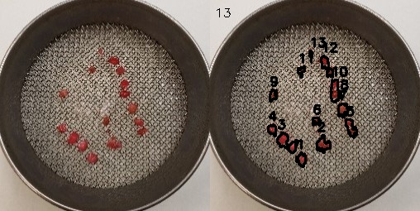
Beginning Case 1 CUPCT4 File: With Piece Count (in pixels)
Strawberry attributes -
CUP 5
piece | x | y | width | height | area
1 | 104 | 184 | 12 | 18 | 67
2 | 129 | 163 | 17 | 22 | 112
3 | 81 | 160 | 25 | 25 | 182
4 | 70 | 150 | 10 | 15 | 261
5 | 164 | 144 | 14 | 23 | 87
6 | 124 | 142 | 10 | 10 | 155
7 | 155 | 125 | 12 | 18 | 53
8 | 157 | 112 | 2 | 7 | 130
9 | 72 | 108 | 9 | 15 | 6
10 | 146 | 96 | 10 | 28 | 73
11 | 106 | 80 | 9 | 14 | 201
12 | 134 | 67 | 15 | 27 | 56
13 | 120 | 61 | 4 | 9 | 156
Information for other images on slide 4 and 5 - LINK
Notes:
Everything is in pixels

Slide 13
What to focus on next?
Whole vs. Partial pieces
What to count?
Size of piece to digital dimension conversion
There is a nuance to counting that may put a damper on this method. Some pieces look like intact pieces yet when touched it becomes apparent that they are “mush”. These pieces aren’t counted.
Sieve size and method discussion
Moving forward would we only test on 1 of the sieves or all? Piece count is just measured on 1 sieve
Making this analysis available (API + User interface)

